Slide 1
Additional Topics for ANN & CNN
Vraj Suratwala
Department of ICT, VNSGU

Slide 2
Types of ANN
Feedforward Neural Networks (FNN / MLP): Data moves in one single direction from the input through hidden layers to the output. They have no loops or memory. They work well for general classification and regression tasks.
Convolutional Neural Networks (CNN): These use filters to scan grid-like data. They excel at computer vision, image recognition, and video analysis.
Recurrent Neural Networks (RNN): These include feedback loops that give the network a form of short-term memory. They process sequential data like speech and text. [1] (https://www.ibm.com/think/topics/neural-networks), [2] (https://learninglabb.com/artificial-neural-network-in-machine-learning/)

Slide 3
Types of ANN
Long Short-Term Memory (LSTM): A special type of RNN. It solves memory loss over long sequences. It works well for machine translation and time-series forecasting.
Generative Adversarial Networks (GAN): Two networks compete—one generates fake data and the other tries to spot it. They create realistic synthetic images and media
Transformers: A modern design using attention mechanisms. They replace older RNNs for large-scale natural language processing.

Slide 4
Transfer Function in ANN
In an Artificial Neural Network (ANN), a transfer function (more commonly known as an activation function) is a mathematical formula that determines the output of a neuron

Slide 5
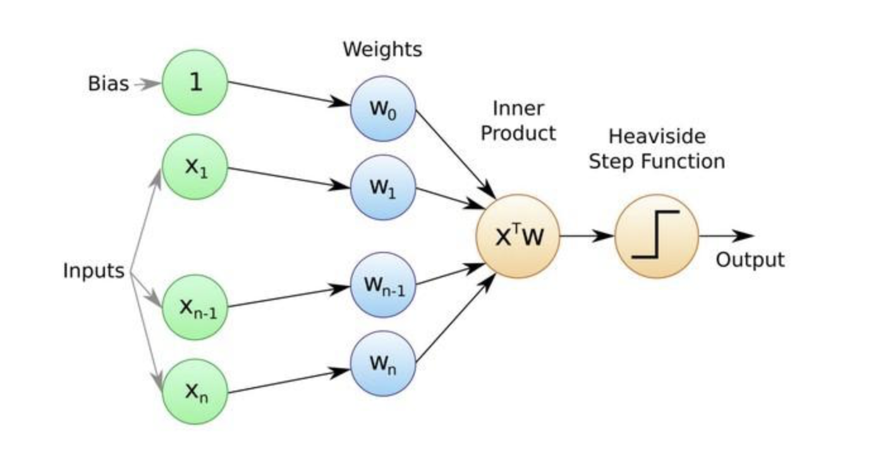
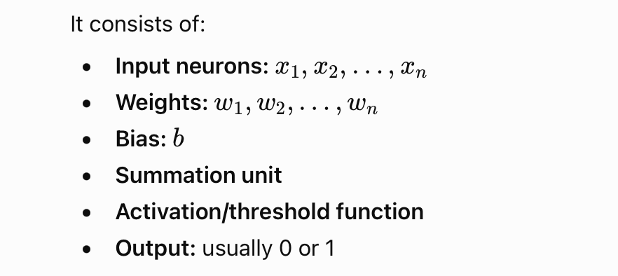
Rosenblatt’s Perceptron
The Rosenblatt Perceptron is a simple single-layer artificial neural network proposed by Frank Rosenblatt in 1957. It is mainly used for binary classification.

Slide 6
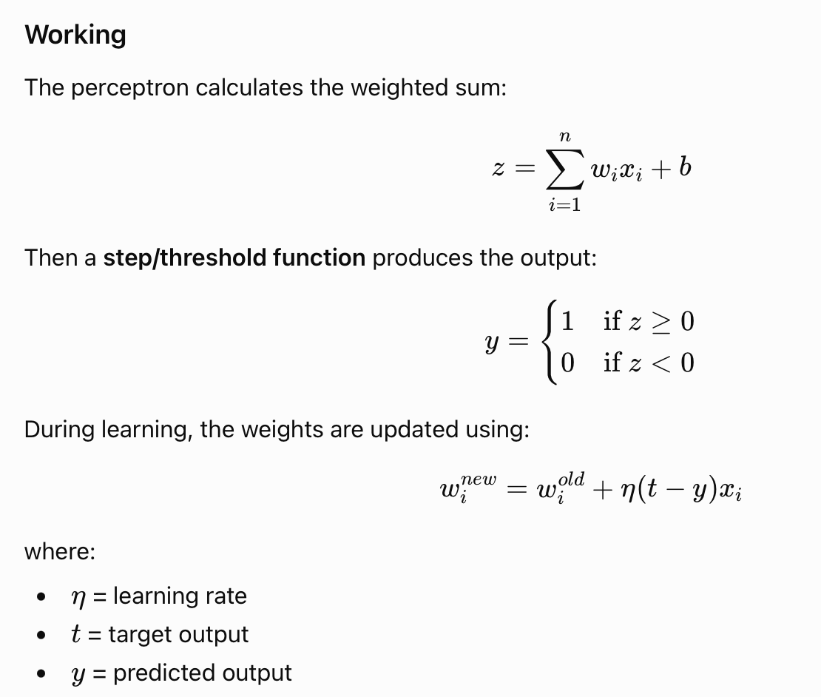
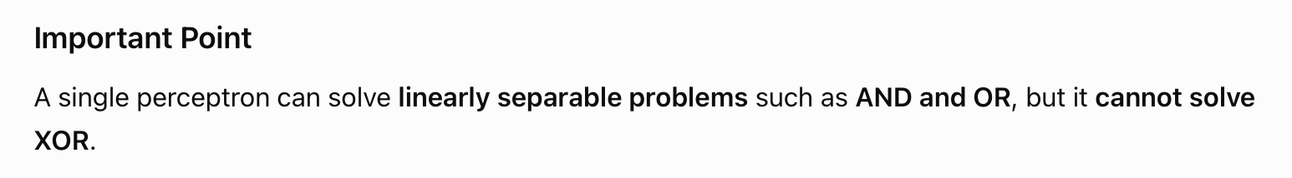

Slide 7
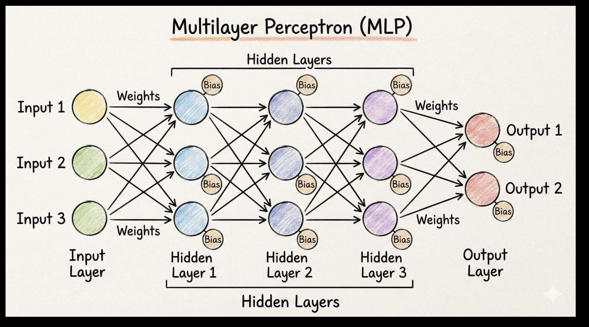
Multi-Layer Perceptron (MLP)

Slide 8

Architecture
Input Layer → Hidden Layer(s) → Output Layer
Each neuron in one layer is generally connected to neurons in the next layer.
Working
Input values are given to the input layer.
Each neuron calculates a weighted sum:
An activation function such as ReLU, sigmoid or tanh is applied.
The output is passed through the hidden layers.
The final layer produces the prediction.
During training, backpropagation calculates the error and updates weights using an optimization method such as gradient descent.

Slide 9
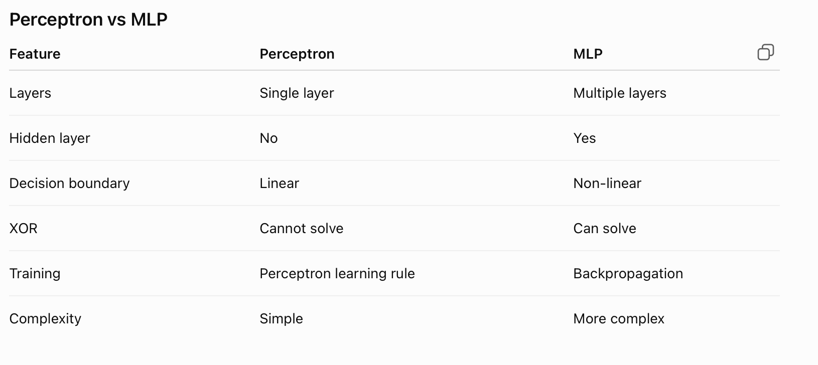
Difference

Slide 10
Thank you
Vraj Suratwala

